Slide 1
Presentation
AWS
LINUX
AWS Intro
Models of cloud
Global Infrastructure
Amazon Elastic compute cloud(ec2)
AMI(Amazon Machine Image)
Autoscaling
vpc(Virtual Private Cloud)
IAM(Identity Access Management)
ALB(Application Load Balancer)
NLB(Network Load Balancer)
Linux operating system
Linux/Root Directory system
Shell scripting
Yum and apt get command

Slide 2
AWS Introduction
The Amazon web services(AWS) are the collection of remotely computing services offer on the internet by Amazon.com here we call it as AWS.
Amazon Web Services provides various services related to the networking, compute, storage.

Slide 3
Models of cloud
We have different type of clouds.
1.service models.
2.Deployment models.
Service Models
In these model we have three type of models, they are
1.Iaas.
2.Paas.
3.Saas.

Slide 4
Global Infrastructure
Region: AWS region is a geographical area consisting of multiple availability zones.
It is used to host and run services and resources like Amazon Elastic compute cloud(ec2)instances, Amazon simple storage service(S3) bucket.
Each region is completely independent and has its own set of services and resources.
AWS current has regions in North America, South America, Europe, Asia, and Australia.

Slide 5
Availability Zones(AZ): It is a single Data center or group of data centres in region.
In AZ the Data centres are located in many miles apart from each other within a distance of 100 km or 60 miles from each other.
Multiple AZ are usually available to protect from natural disasters or data outages.

Slide 6
Iaas(Infrastructure as service)
Iaas is also called as “Hardware as a service”(Haas).
It is one the layer in cloud computing, it provides computing infrastructures and physical or virtual machines and other resources like load balancer, ip address, network etc…
Ex: Amazon Ec2, window Azure etc..
paas(Platform as service)
Paas provides runtime environment. It allows programmers to easily create, test, run and deploy web applications.
Ex: Google cloud, IBM cloud, AWS Elastic beanstalk.
Saas(Software as service)
Saas is also called as On “Demand Software”.
It allows the users to connect and use cloud based apps on the internet.
Ex: Gmail, Google apps.

Slide 7
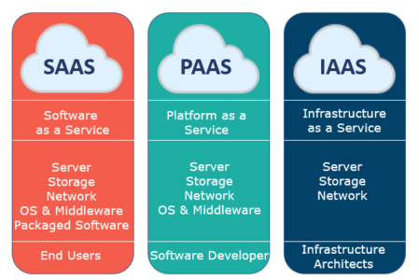

Slide 8
Deployment models
1.Private cloud
It is used to select the offers on the internet.
It provides greater security controls.
2.Public cloud
It is offered by the third party providers.
Available to everyone on the internet.
3.Hybrid cloud
It is the combination of both private and public cloud.
It helps to control high control on the sensitive data and process.

Slide 9
Amazon Elastic Compute Cloud(EC2)
Amazon Elastic compute cloud will provide computing capacity in the Amazon Web Services(AWS cloud).
It is used to develop and deploy applications faster.
It is having two storage options is of EBS & instance stores.
We can use Amazon EC2 to launch as many as or few virtual servers as u need.

Slide 10
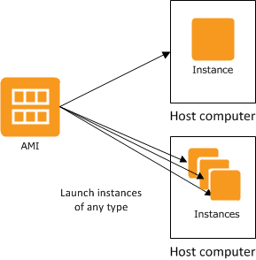
AMI(Amazon Machine Image)
Amazon Machine Image is a template that contains a software configuration like operating system, applications.
It is used to create virtual machine within the EC2 Instance.
We can create multiple Instances using single AMI.
The Instances keep running until we stop, terminate them.

Slide 11
Autoscaling
AWS Autoscaling is a service provided by Amazon Web Services(AWS) that automatically adjusts the number of Amazon Elastic Compute Cloud(EC2) instances.
In an EC2 Autoscaling group based on CloudWatch Alarms.
In Autoscaling the Instances will run Automatically based on traffic demand.

Slide 12
VPC(Virtual Private Cloud)
Vpc is a service that allows users to create a private network in the AWS cloud.
Vpc is a virtual network that resembles a traditional network.
Vpc is the networking layer of Amazon EC2
Networking:
1. Ip address.
2. Subnets.
3.Route.
4.Internet.

Slide 13
Internet Gateway
An Internet gateway is a virtual router that connects vpc to the internet.
By default the vpc is already attached to internet gateway.
If we create new vpc we have to attach internet gateway in order to access the internet.
NAT Gateway
NAT is of Network Address Translation.
NAT is to enable instances in a private subnet to connect to the internet.
For creating NAT gateway we have to specify the public subnet.

Slide 14
IAM(Identity Access Management)
Amazon IAM is a web service that helps you securely control access to AWS resources.
With IAM we can create and manage AWS users and groups and use permissions to allow and deny their access to AWS resources.
In IAM we have 4 components
1.user.
2. Policies.
3.groups.
4.roles.

Slide 15
Application Load Balancer(ALB)
An Application Load Balancer (ALB) is a type of load balancer offered by Amazon Web Services (AWS) that distributes incoming network traffic across multiple targets, such as EC2 instances, containers, and IP addresses.
It simplifies and improves the security of the application.
Network Load Balancing
Network Load Balancing (NLB) is a method of distributing incoming requests across multiple servers so that they can be handled more efficiently.
It is integrated with other popular AWS services like Autoscaling, Amazon ec2 container service.

Slide 16
Linux
Linux is a unix-like, open and source and community developed operating system(os) for computers, servers, mainframes, mobile devices.
The linux os can be found in many different settings, supporting different use cases.
It is used in following ways.
1.server OS.
2.Desktop OS.
3.Headless server OS.
4.Appliance OS.
5.Network OS.
6.Software Development OS.
7.Cloud OS.

Slide 17
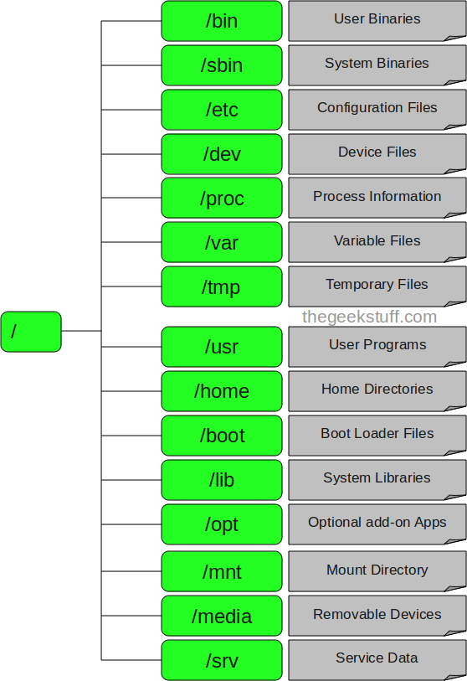
Root Directory Structure

Slide 18
Basic Linux Commands
pwd(present working directory):
Used to know where we are/location.
Sudo su:used for creating root user.
Mkdir:used to create directory.
Touch:To create file.
To create multiple files we use
Vi filename.
Nano filename.
Cat >filename.
Echo” content”filename.
Printf
Rm:used to remove file.
Mv: used to change filename.
Ls: used to see the list of the files.
Cp: used to copy files.
Cd: used to change directory.
Chmod: used to give permissions to the file or directory.
Wc: used to see the lines count, word count, characters count.
Find-type f-name filename:
Used to find files.
Find-type d-name filename:
Used to find directory.

Slide 19
Shellscripting
Shell script is a list of commands in a computer program that is run by Unix shell which is a command line interpreter.
The different operations performed by the shell scripts are program execution, file manipulation, and text printing. A wrapper is also a kind of shell script that creates the program environment, runs the program.

Slide 20
Yum and apt getcommand
YUM is the primary package management tool for installing, updating, removing, and managing software packages in Red Hat Enterprise Linux.
Apt-get provides a simple way to install packages from the command line.

